Slide 1

Welcome

Slide 2
AND Digital is a new way for digital delivery. We help clients reach their digital aspirations, so they can do much more for their customers!

Slide 3
Guide
Provide Digital and product management expertise.
Advise on the right technology needed to underpin the product vision.
Design and implement digital organisation, including ways of working and behavioural changes to achieve agility needed.

Slide 4



Build
Product analysis
Provide crucial link between a Product Manager or Product owner and a Developer to enable smooth delivery of digital products.
Product development
We bring great coders that are focused on building quality digital products with our clients.
Agile Product Delivery
Agile delivery framework adaptable to existing client environments.

Slide 5
Teach
We work in two teams who jointly accelerate digital capability and forge high performance teams and leaders.
We deliver AND Digital’s award-winning academy which onboards people and provides them with a continuous learning experience.
We have a team of subject matter experts who coach, mentor, and upskill people in Agile, Tech, Digital, and Professional practices.

Slide 6

What is Agile?
Agile is a collection of values and principles. Agile’s real utility is giving people a common foundation for making decisions about the best way to develop a software.

Slide 7
Values
Agile
Individuals and interactions
Working software
Customer collaboration
Responding to change
Standard processes
Processes and tools
Comprehensive documentation
Contract negotiation
Following a plan

Slide 8
Priorities
Satisfy the customer through early and continuous delivery of valuable software.
Welcome changing requirements even late in development. Agile processes harness change for the customer’s competitive advantage.
Deliver working software, from a couple of weeks to a couple of months, with a preference to the shorter timescale.

Slide 9


How does a team become Agile?
They make decisions based on Agile values and principles. The values and principles have enough flexibility to allow teams in a wide variety of organisations to develop software in a way that works best for their particular situation while providing enough direction to help a team continuously move toward their full potential.

Slide 10


Golden Shoe

Slide 11
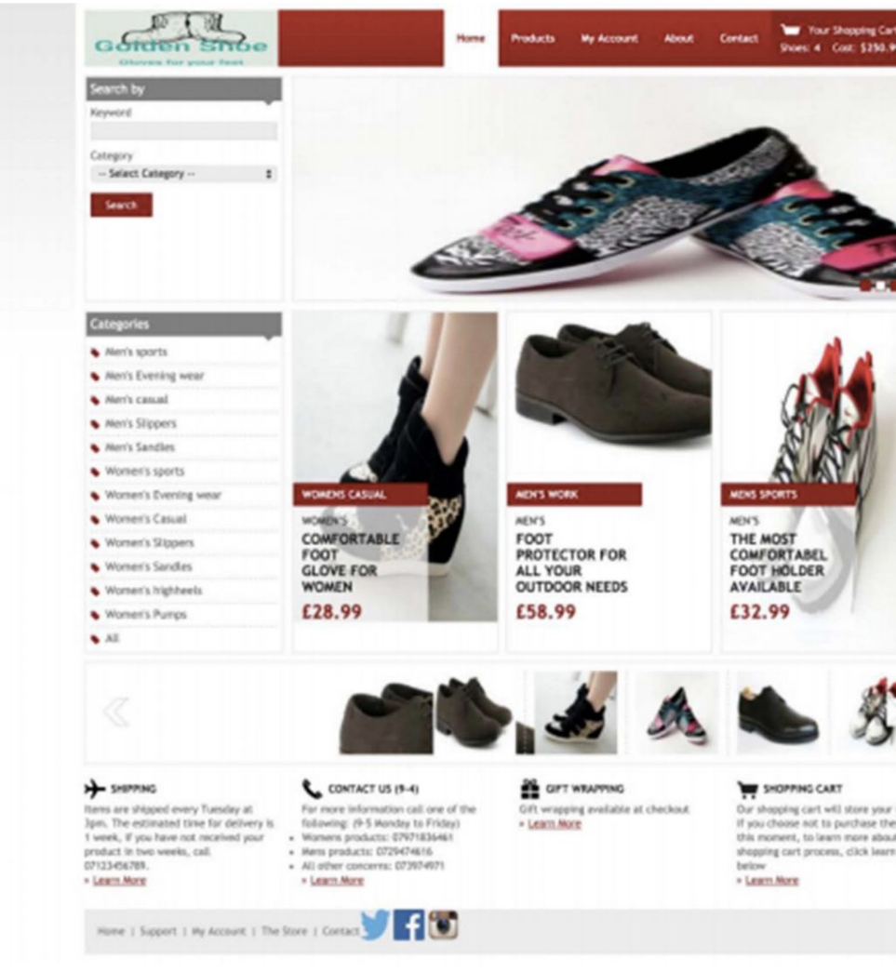
Current solution
Challenges
Unresponsive/No mobile phone friendly
Items showing as in stock, but actually being out of stock (and the customer is still able to ‘check out’ the item even though it is out of stock)
Discount vouchers only in-store
Queries around delivery dates and time
Returns process

Slide 12

Demo

Slide 13

Emil Ivanov
AND Digital Software Developer
Email: emil@eivanovue.com
Mobile: +447932893920
Website: eivanovue.com

